Slide 1
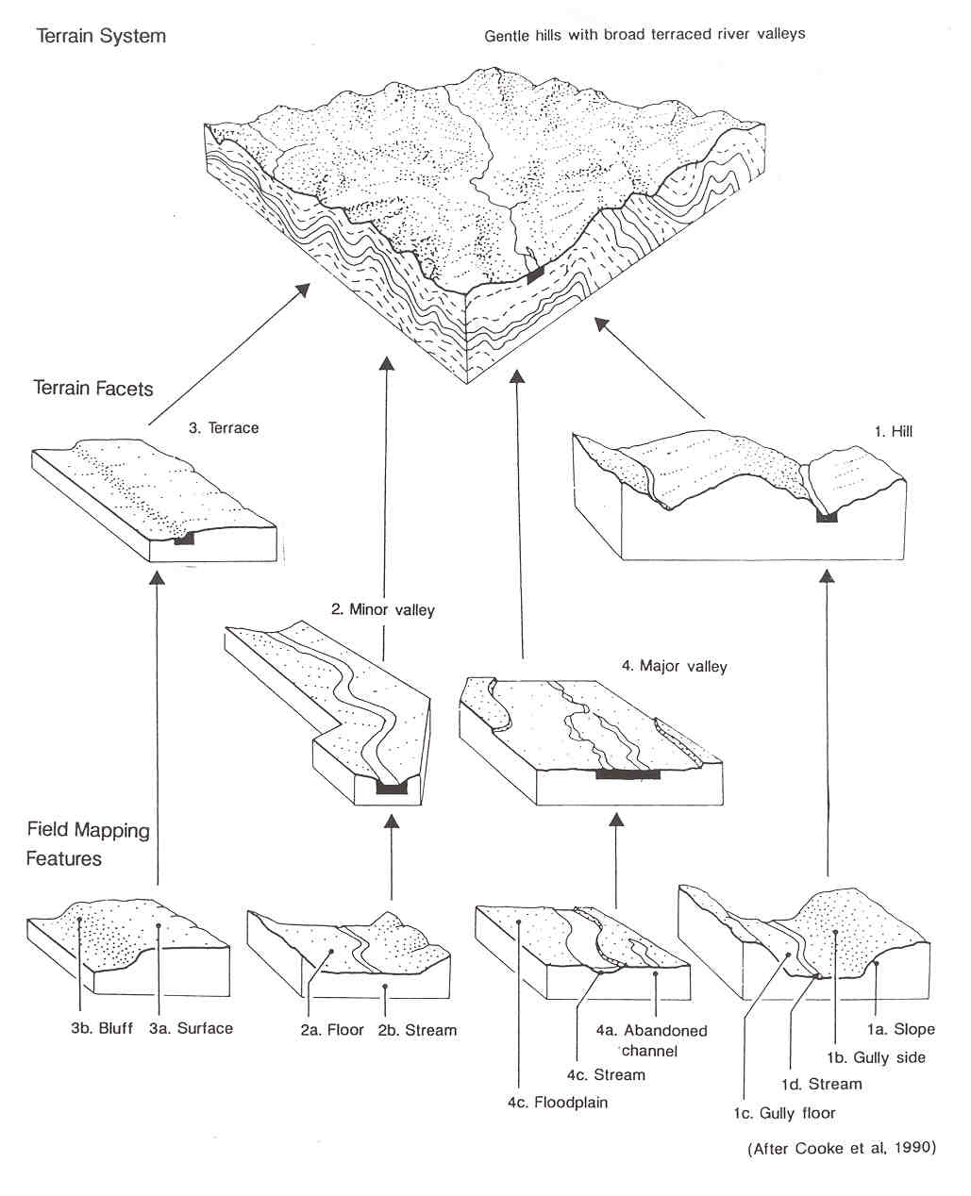
Figure 3.1 Terrain Classification System (from Phipps, 2001)

Slide 2
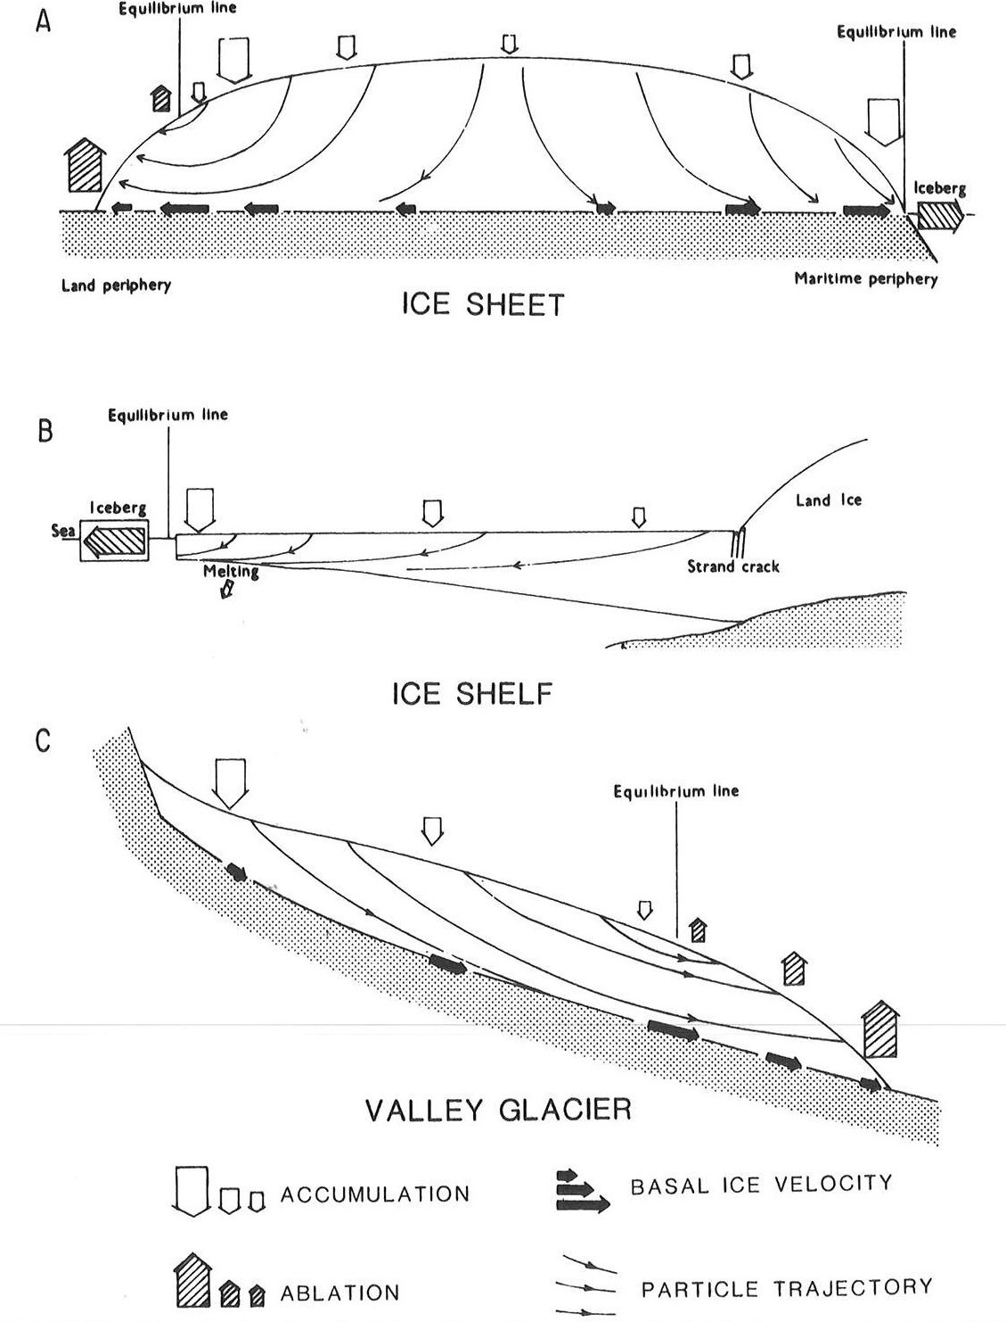
Figure 3.2. From Sugden and John (1976). Various types of glacier showing distribution of snow input, ice outputs and ice flow characteristics:
Ice sheet
Ice shelf
Valley glacier
Equilibrium line is the point where accumulation equals ablation

Slide 3
Figure 3.3 From Addision (1983). Glacial process-response systems: a) erosive processes and glacial types; b) erosional landforms; c) stratigraphy; d) sedimentary landforms.
Z1 – zero or low basal velocities and little meltwater. This is the ice-shed zone of cold based ice sheets which severely hampers erosion processes.
Z2 – away form the ice dispersal zone abrasive scour is more common and evidence of basal ice ‘streaming’ at depth quarrying bedrock channels. This is the selective erosion zone.
Z3 – local ice thickening increases basal shear stress and pressure melting leading to extensive quarrying and abrasion. This is the outlet glacier zone
Z4 - beyond the constriction of glacial troughs the ice fans out in the piedmont zone

Slide 4
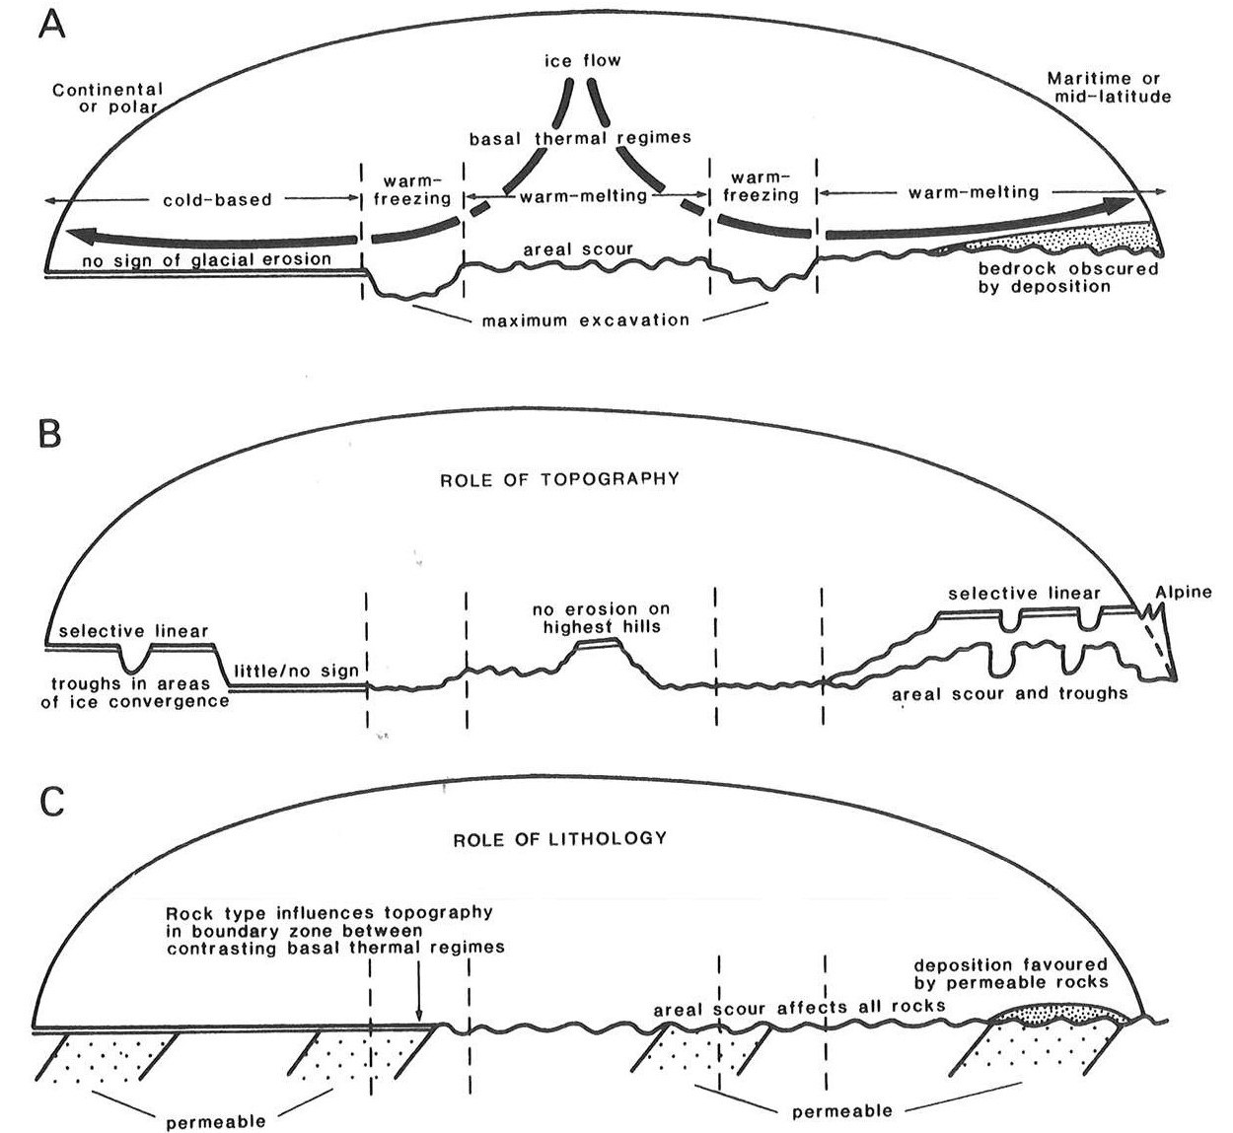
Figure 3.4. From Chorley et al (1984). Model of erosion by ice sheets. Left side of figure are high latitude and continental conditions; right side of figure represents maritime or mid-latitude conditions.
Main basal regimes and idealised erosional effects
B) Effect of topography showing how highlands experience mineral erosion of selective linear erosion, lower uplands in maritime areas, however, may be scoured. High ground massifs above the ice sheet are shaped by alpine valley glaciers
Effects of bedrock permeability which can modify erosion and deposition patterns notably at the boundary between basal thermal zones

Slide 5
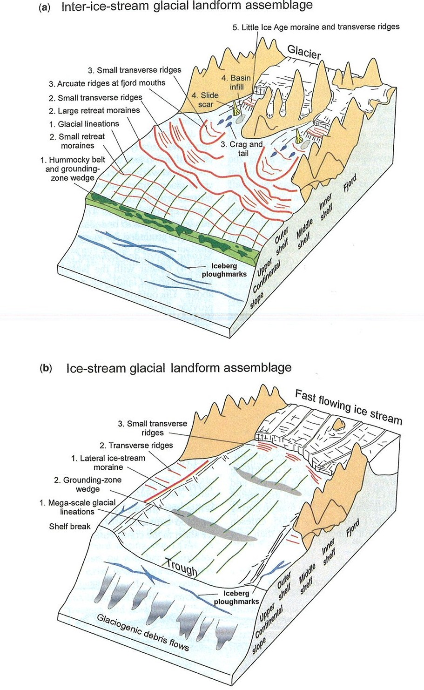
Figure 3.5. From Ingólfsson (2011) based on Ottesen & Dowdeswell (2009). Models of the submarine glacial landforms on the Svalbard continental margins, The landforms are labelled by their relative age of deposition, where 1 denotes the oldest:
A) Inter ice-stream glacial landform assemblage located between fast flowing ice streams
B) An ice-stream glacial landform assemblage where fast flowing ice was from large interior drainage basins.

Slide 6
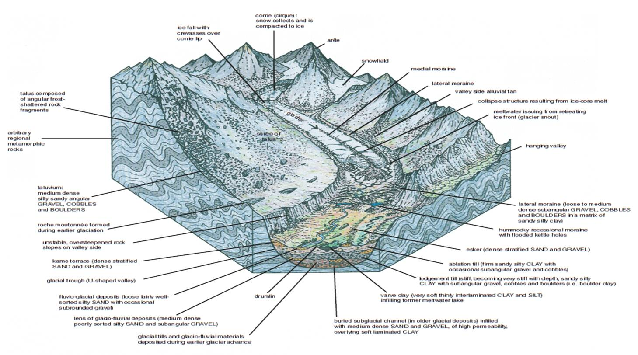
Figure 3.6. From Fookes et al (2007). Conceptual model of a retreating valley glacier showing a range of erosional and depositional landforms

Slide 7
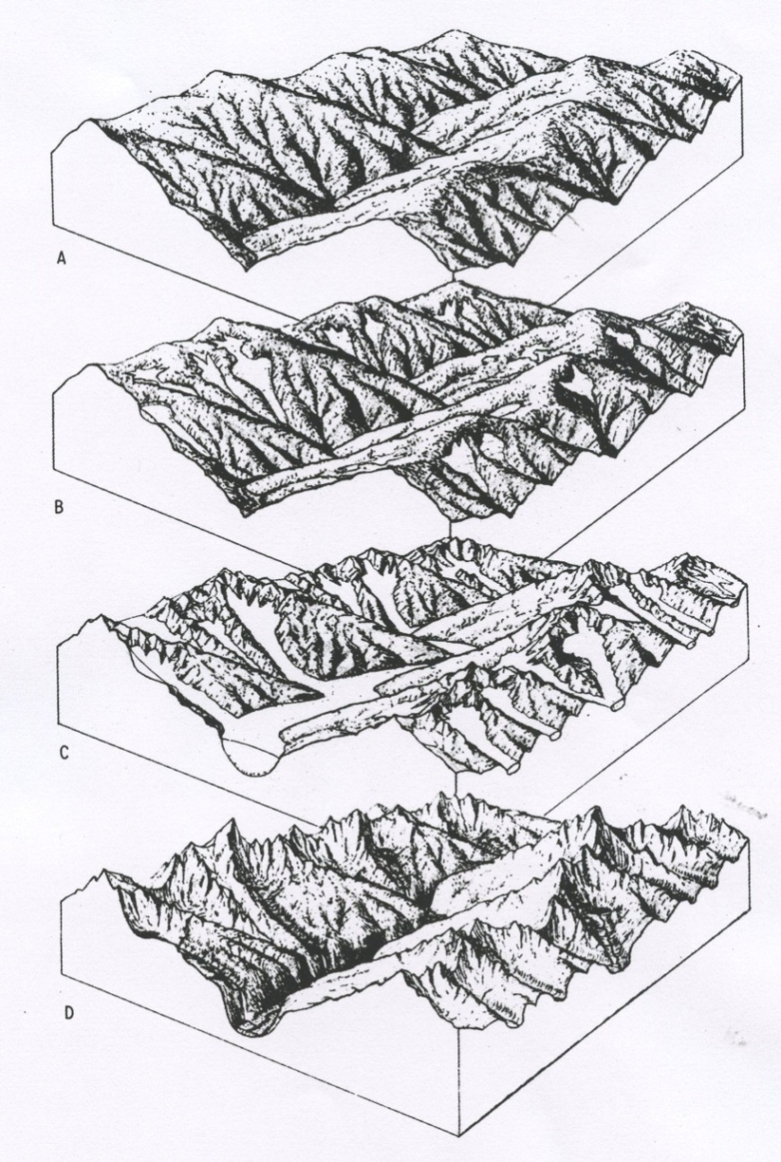
Figure 3.7. From Flint (1971) adapted by Chorley et at (1984). The effects of alpine glaciation:
A) Mountains before glaciation
B) The growth of glaciers in topographic hollows
C) Network of valley glaciers
D) Area after deglaciation showing range of erosional features

Slide 8
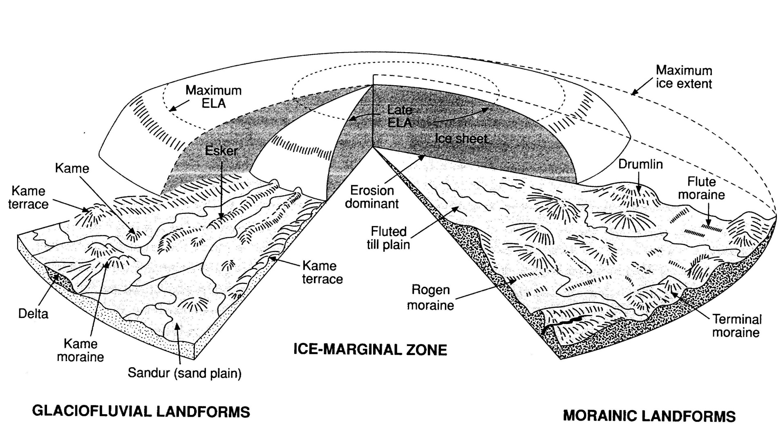
Figure 3.8. From Smithson et al (2002). Ice sheet depositional landforms. Glaciofluvial and morainic landforms shown in relation to glacial retreat stages. Often the suite of landforms are superimposed and it can be difficult to differentiate between them.
ELA – equilibrium line altitude

Slide 9
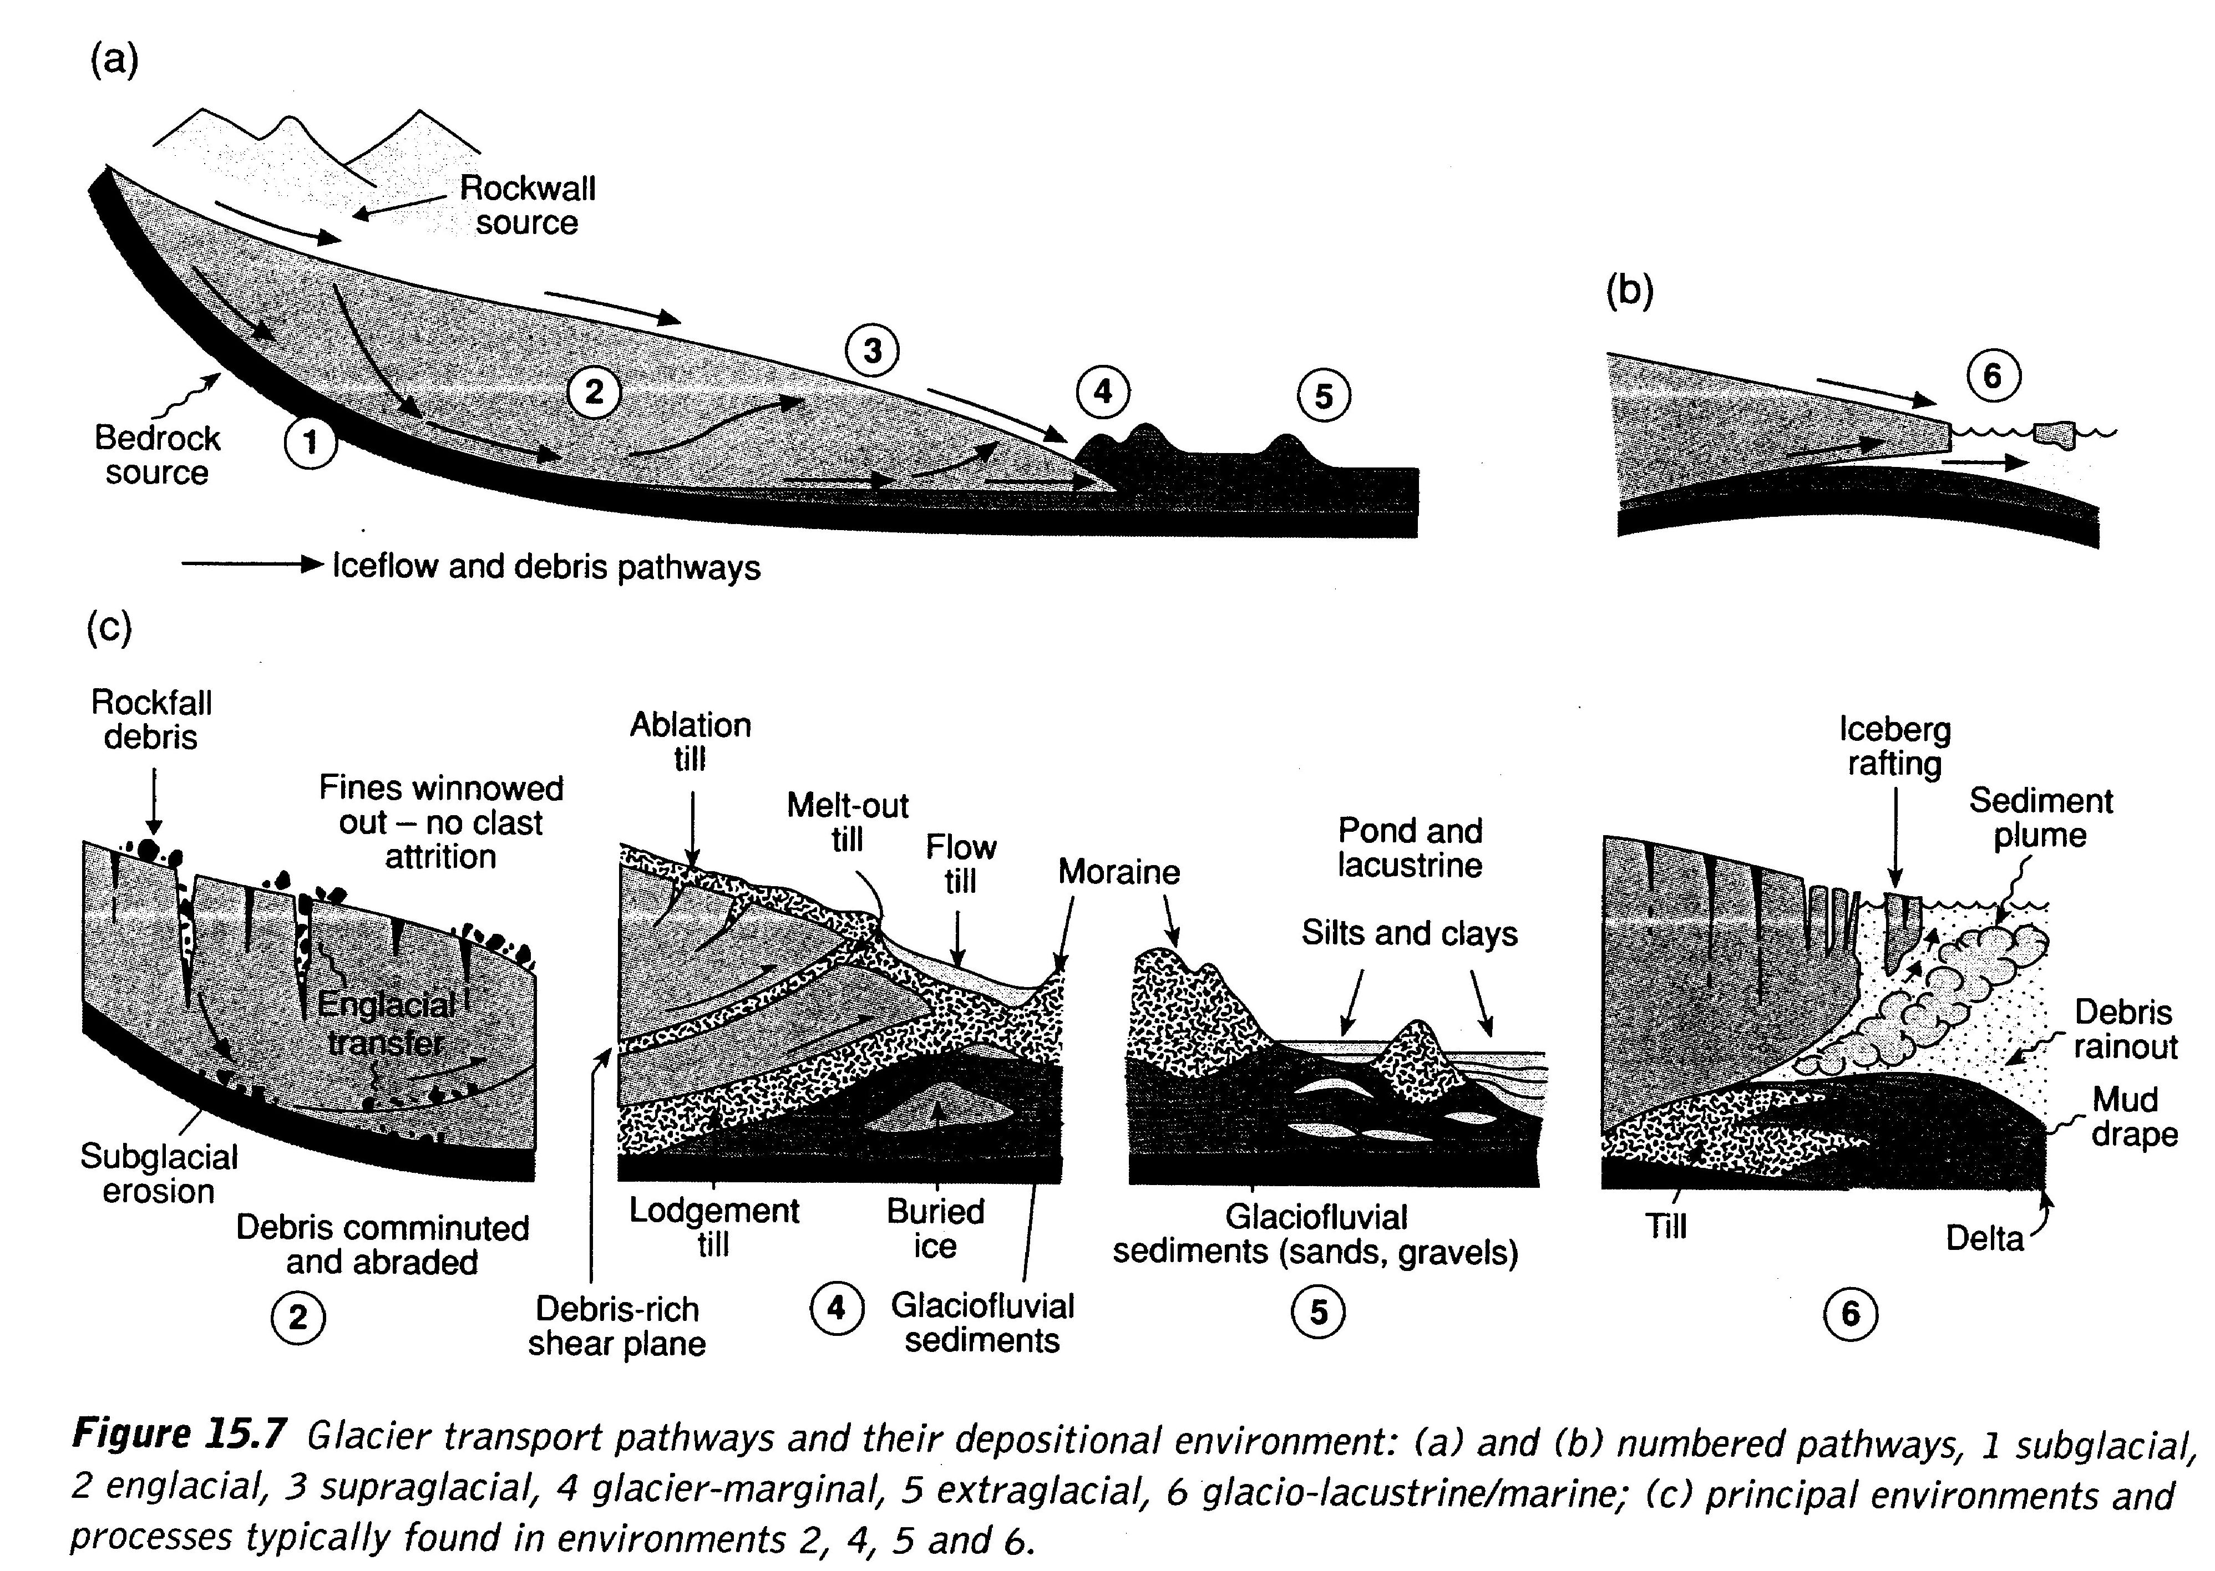
Figure 3.9. from Smithson et al (2002). Glacial transport pathways and their depositional environment; (a) and (b) show the numbered transport pathways in a valley glacier (a) and a calving sea ice glacier (b): 1) Subglacial; 2) englacial; 3) supraglacial; 4) glacier-marginal; 5) extra-glacial; 6) glacio-lacustrine/marine. c) Shows the principal environments and processes associated with the numbered pathways

Slide 10
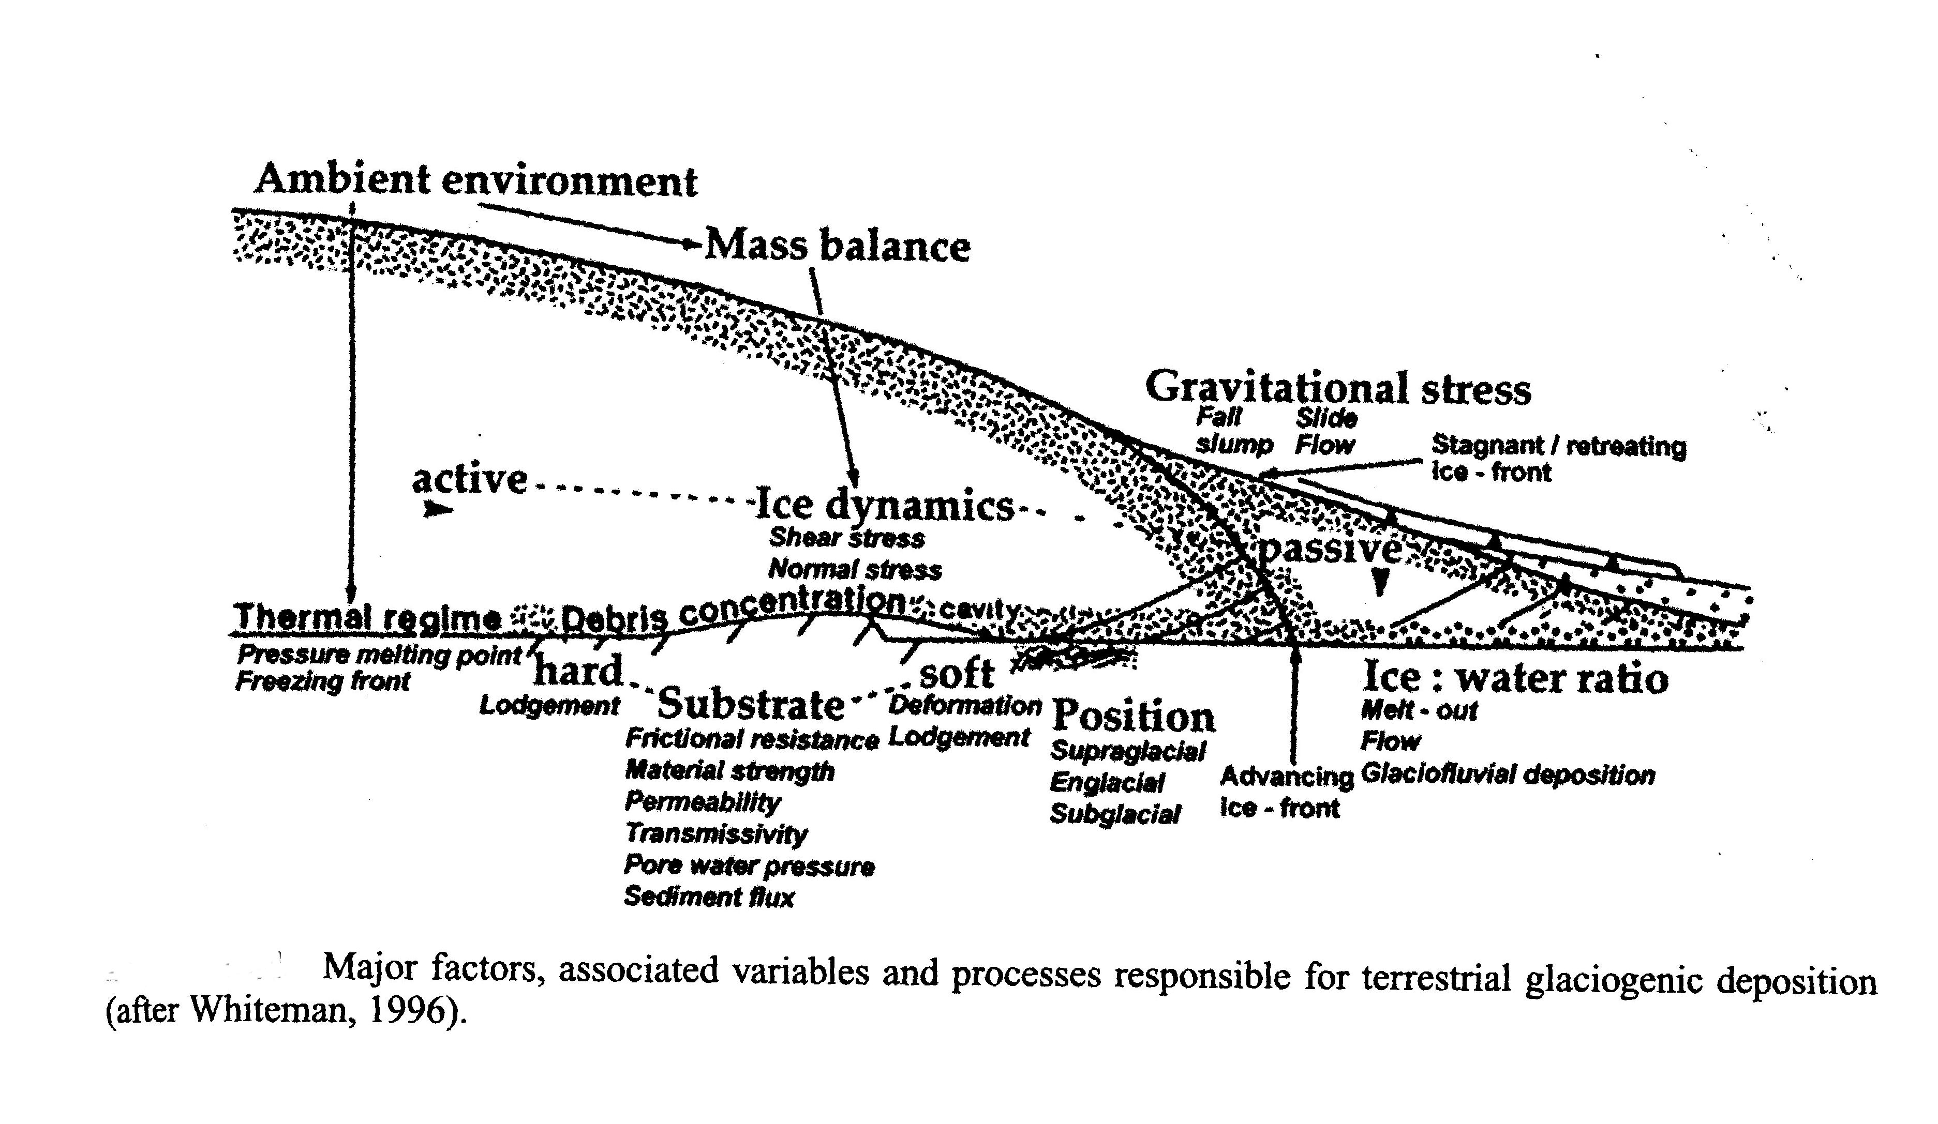
Figure 3.10 from Whiteman (1996). Major factors and associated variables and processes responsible for terrestrial glaciogenic deposition

Slide 11
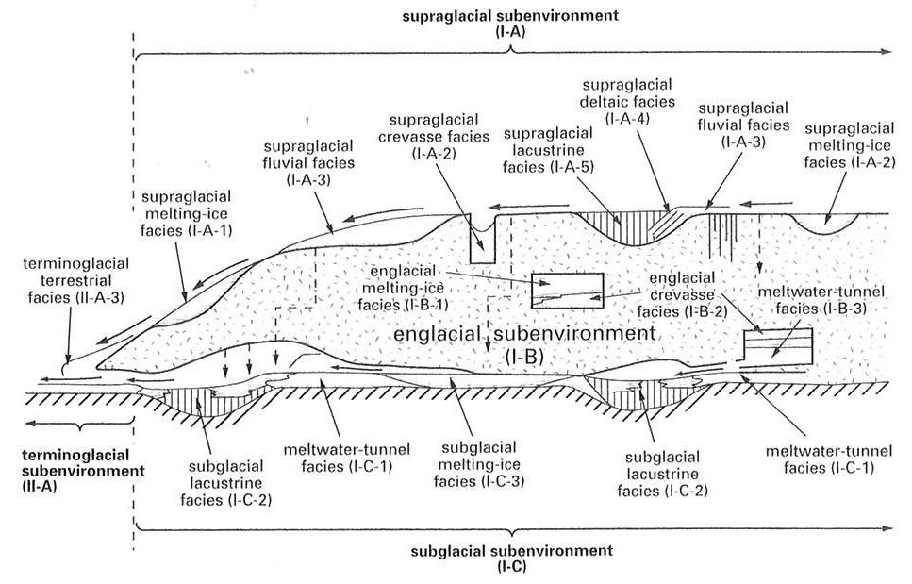
Figure 3.11 from Lowe & Walker. Schematic model of the supra-, en-, and subglacial subenvironments within the marginal zone of a continental ice mass. A classification of the principal sediment facies in ice-marginal zones is provided in Table 3.2 (from Brodzikowski & Van Loon, 1987

Slide 12
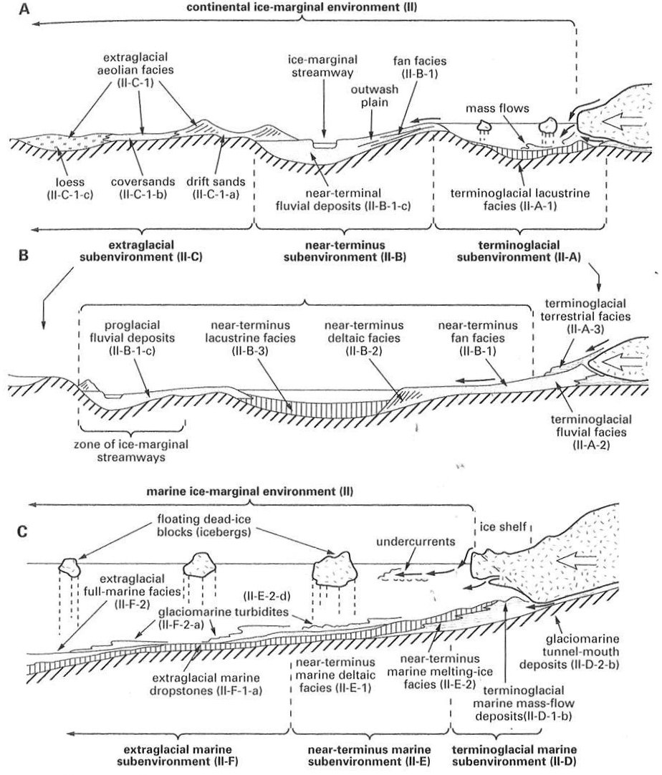
Figure 3.12 from Lowe & Walker 1997. Schematic modes of deposition associated with a glacier margin: A and B illustrate the variety of sediment types associated with continental ice margins; C illustrates the sediment types associated with the marine ice-marginal environment. A classification of the principal sediment facies in ice-marginal zones is provided in Table 3.2 (from Brodzikowski & Van Loon, 1987)

Slide 13
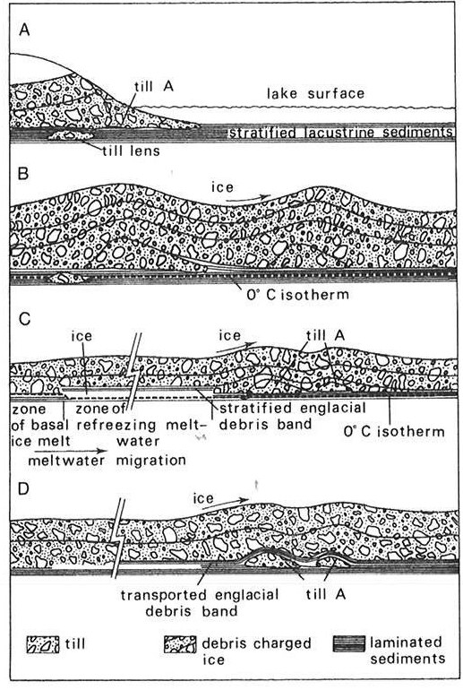
Figure 3.13 from Shaw (1971). Hypothesis for the origin of a compound till and stratified sediment sequence formed during one glacial episode in Shropshire, United Kingdom.
The hypothesized sequence of events is as follows:
A) Deposition of till A
B) Transport of till B and stratified sediment across till A during the advance of a cold-based glacier
C) Increased thickness of ice up-glacier from till A caused the basal ice to warm to pressure melting point and the stratified sediment is incorporated into the glacier in regelation zone down-glacier
D) This illustrates the transport of the now englacial stratified sediment across till A

Slide 14
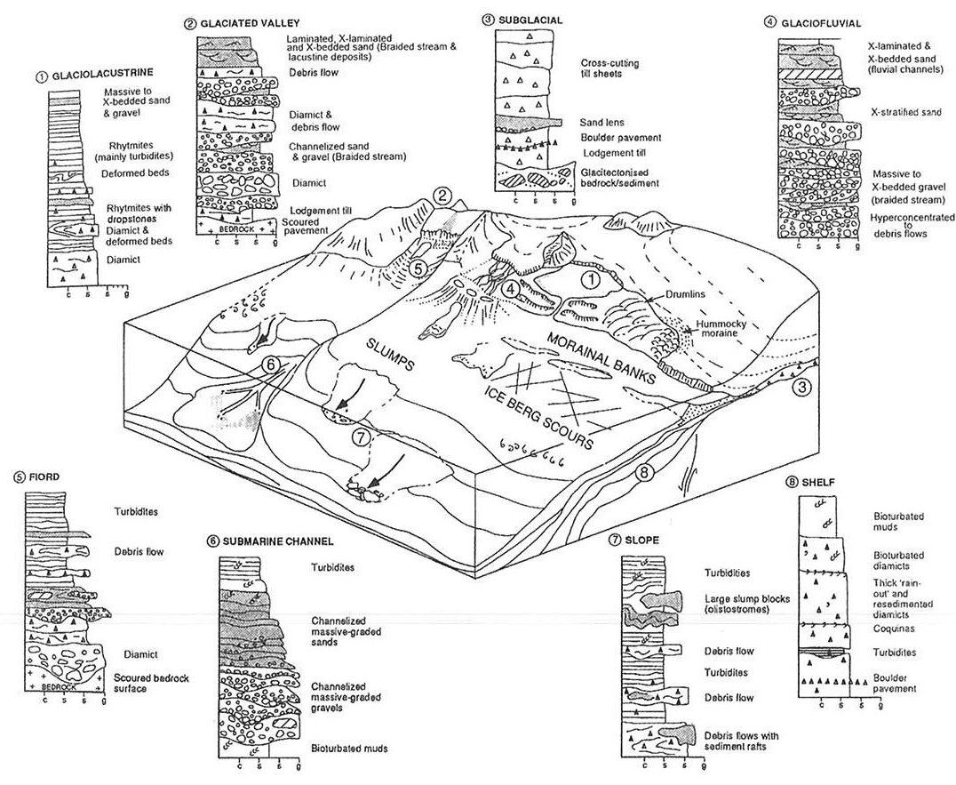
Figure 3.14 From Eyles and Eyles (1992)
Schematic model of principal terrestrial and marine environments and sedimentary sequences formed during a single advance and retreat of a temperate glacier

Slide 15
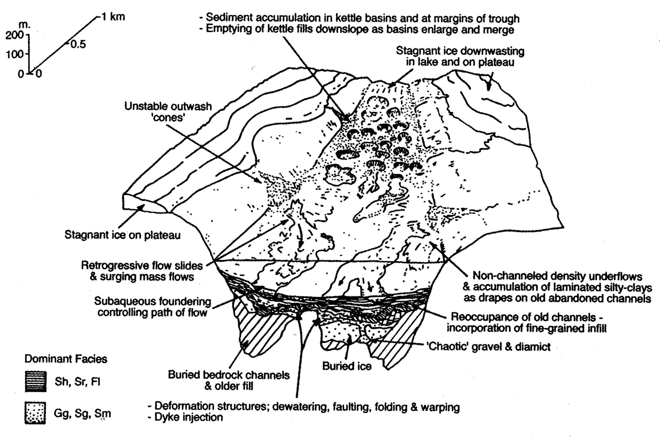
Figure 3.15 from Eyles et al (1987). Model for sedimentation in a supraglacial lake system in an area of moderate to high relief, based on the stratigraphy of the Fraser River Valley, British Columbia, Canada.

Slide 16
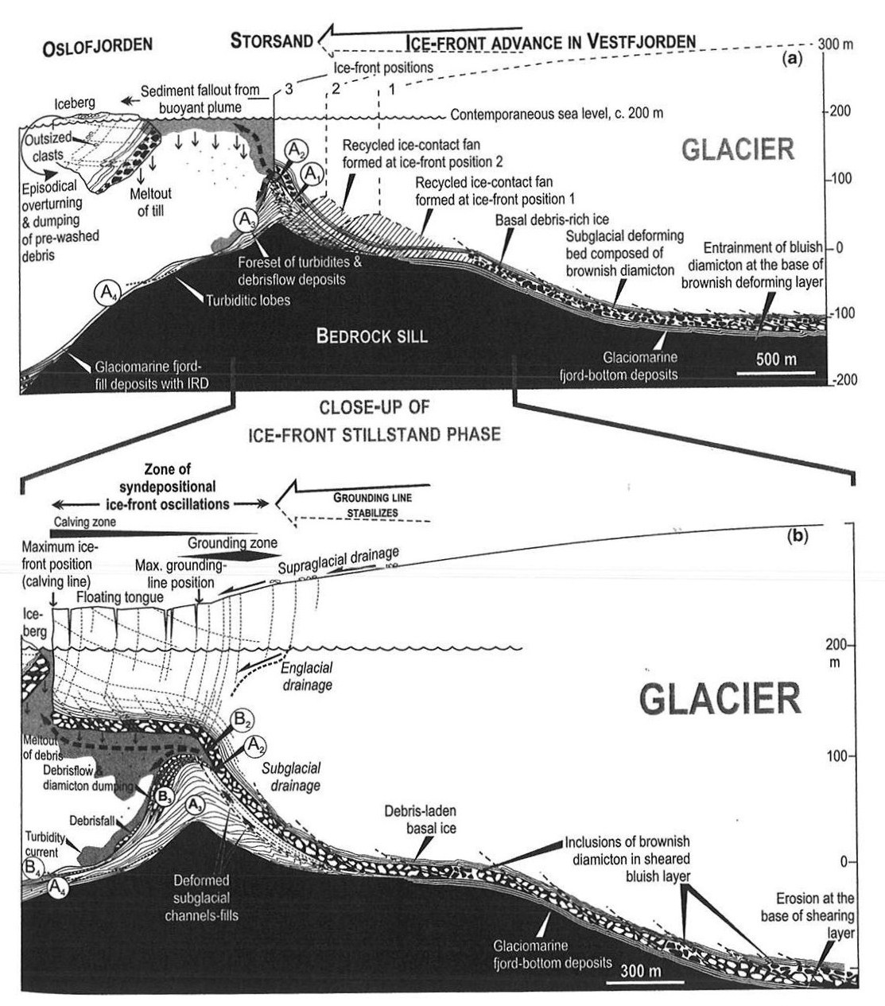
Figure 3.16 from Lønne & Nemec (2011). Development of the Storsand moraine.
(a) Longitudinal profile showing the outlet glacier advancing southwards onto the bedrock sill at Storsand and forming an ice-contact submarine fan unit (Unit A); the present day bedrock topography with sediment cover. The subglacial till layer composed of brownish-grey diamicton formed during the glacier advance
(b) Close-up depiction of the glacier front durin gits stillstand with persisting ice flux, deposition of Unit B and the brownish till increasingly replaced by a bluish-grey variety.

Slide 17
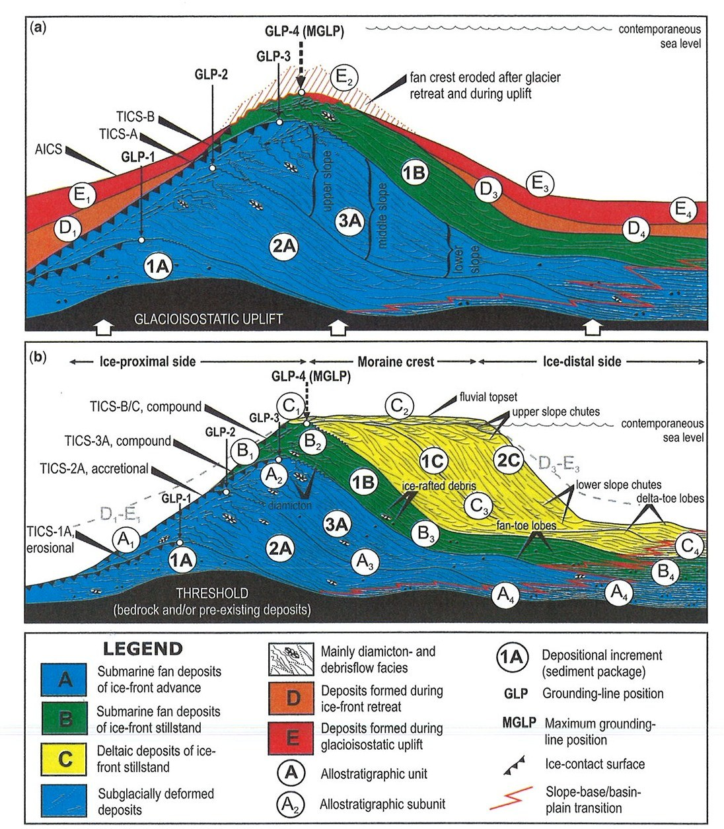
Figure 3.17 from Lønne and Nemec (2011). Allostratigraphic model for the development of marine moraines.
A) Moraine formed by glacier advance (submarine fan unit A) and short stillstand (submarine fan unit b), draped with sediments deposited during the glacier front retreat (unit D) and the subsequent emergence by regional glacio-isostatic uplift (unit E). A monoepisodic moraine will lack unit B and signify a negligible stillstand episode.
B) A fully developed polyepisodic moraine with ice-advance submarine eunit A, a stillstand submarine –fan unit B and stillstand deltaic unit C. The moraine draping units D and E will be the same as those in Figure A.
AICS and TICS are the ‘apparent’ and ‘true’ ice contact surfaces. The GLP is the ‘grounding line position is the boundary between the subglacial and proglacial realm which may coincide with the ice-front position or be considerably offset from the latter in the case of a floating tidewater front or an ice shelf

Slide 18
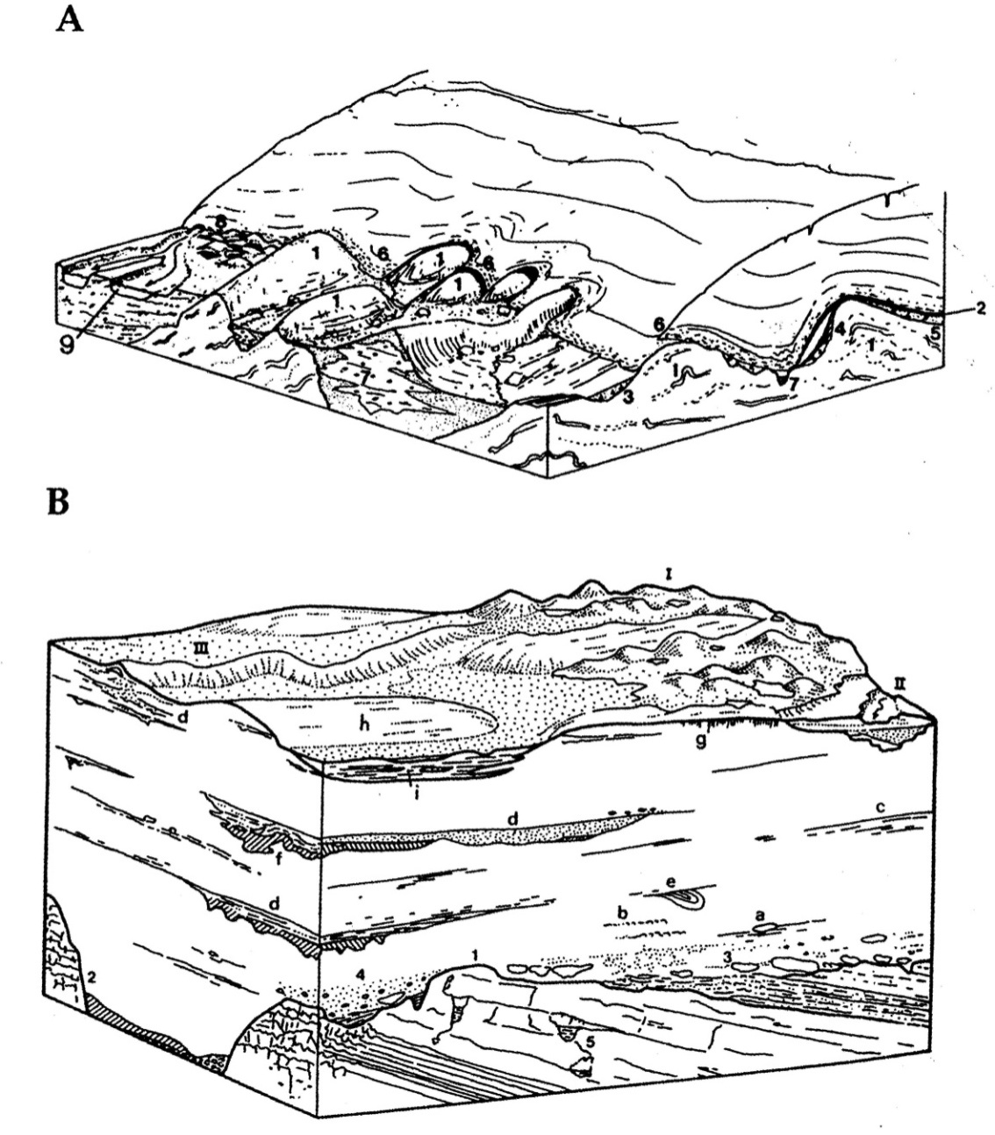
Figure 3.18 from Eyles (1983; Benn & Evans, 1998)
A) Subglacial process-response system in an area of hard bedrock; 1) abraded and stream-lined rock knobs; 2) basal debris; 3) lodgement till on low-relief rock surface; 4) lee-side cavity fill; 5) basal melt-out till; 6) debris melting out at ice surface and dumped by gravity on freshly exposed subglacial surface; 7) subglacial esker with gravel core; 8) hummocky or kettled outwash surface produced by the melt-out of ice buried by outwash fans; 9) the proglacial stream carrying subglacial abrasion products
B) The subglacial process-response system in an area of low relief limestone terrain where multiple stacked till units have been deposited during a single glaciation. This subglacial process-response system has been reworked by: I) hummocky kame-and-kettle topography; II) outwash cut into the till surface and comprising stratified sands; III) esker deposited during ice wastage and therefore not truncated by subglacial tills like other channel fills.
The base of the subglacial process-response system is characterised by: 1) striated rock head; 2) buried channel/valley with a fill of subglacial sands, gravels and general till; 3) glaciotectonised rockhead with rock rafts and boulder pavements; 4)lowermost till comprising local lithologies which thicken in the lee side of rock protuberances as lee-side cavity fills; 5) cold water karst.
The sediments of the system are characterised by; a) predominantly preferentially aligned, faceted clasts;b) crude shear lamination produced by the smearing of soft lithologies (deformation till/glaciotectonite); c) slickensided edding planes produced by glaciotectonic shear; d) stratified gravels, sands and clays deposited in subglacial cavities, pipes or canals and truncated by overlying till; e) folded and sheared off channel fill; f) diapiric intrusion of till squeezed up into subglacial cavity; g) vertical joints produced by post-depositional pedogenic processes; h) drumlinised surface of upper till sheet; i) inter-drumlin depressions filled with post-glacial solifluction debris and peat.

Slide 19
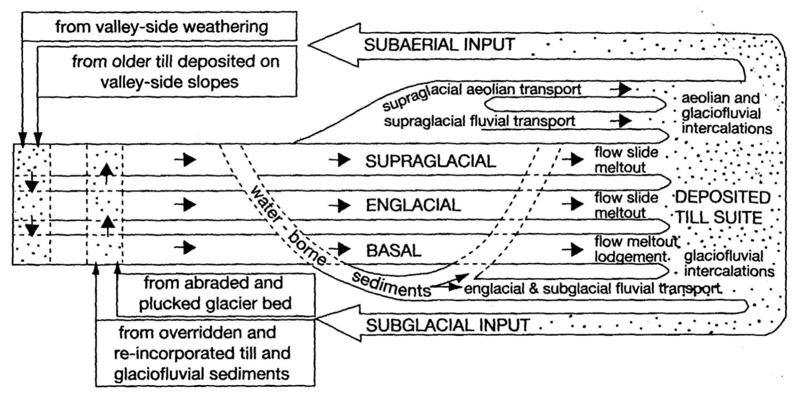
Figure 3.19 from Derbyshire et al (1979). Schematic diagram showing the various glacial sediment systems

Slide 20
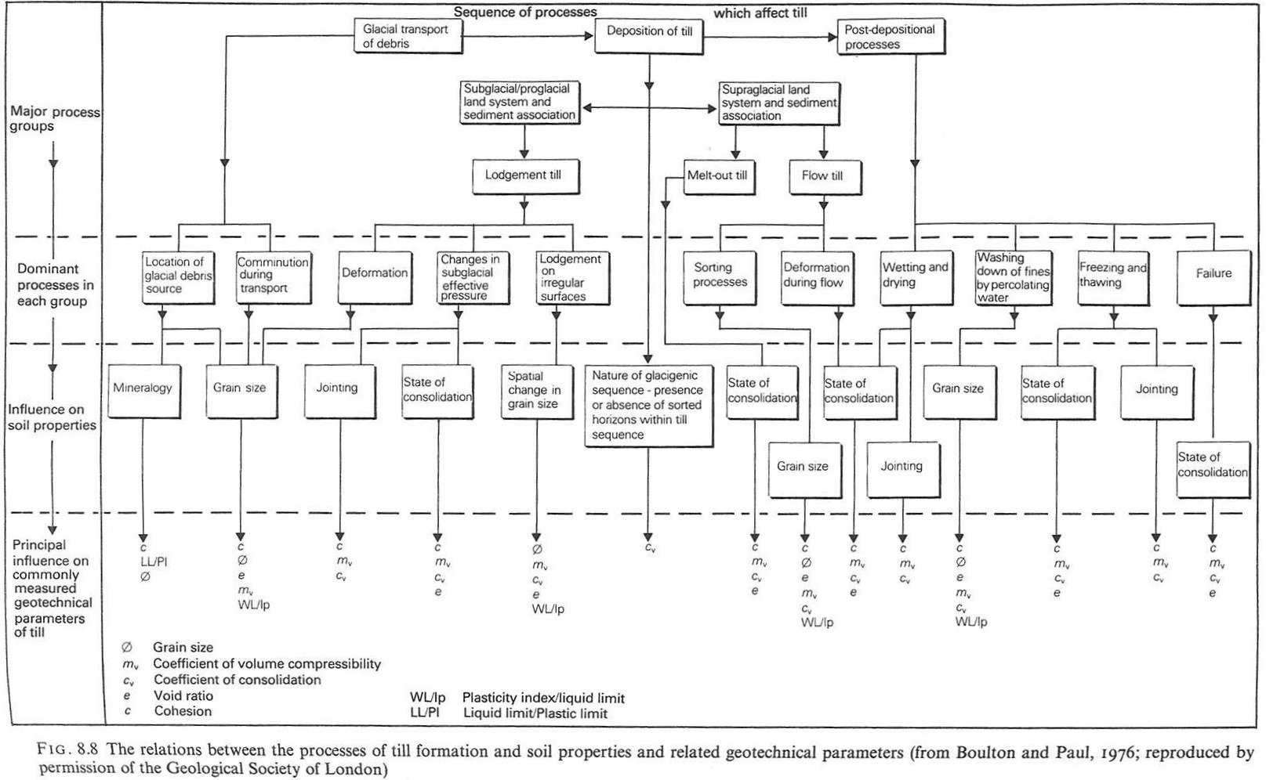
Figure 3.20 from Boulton & Paul (1976). Relationship between processes of till formation, soil properties and related geotechnical parameters

Slide 21
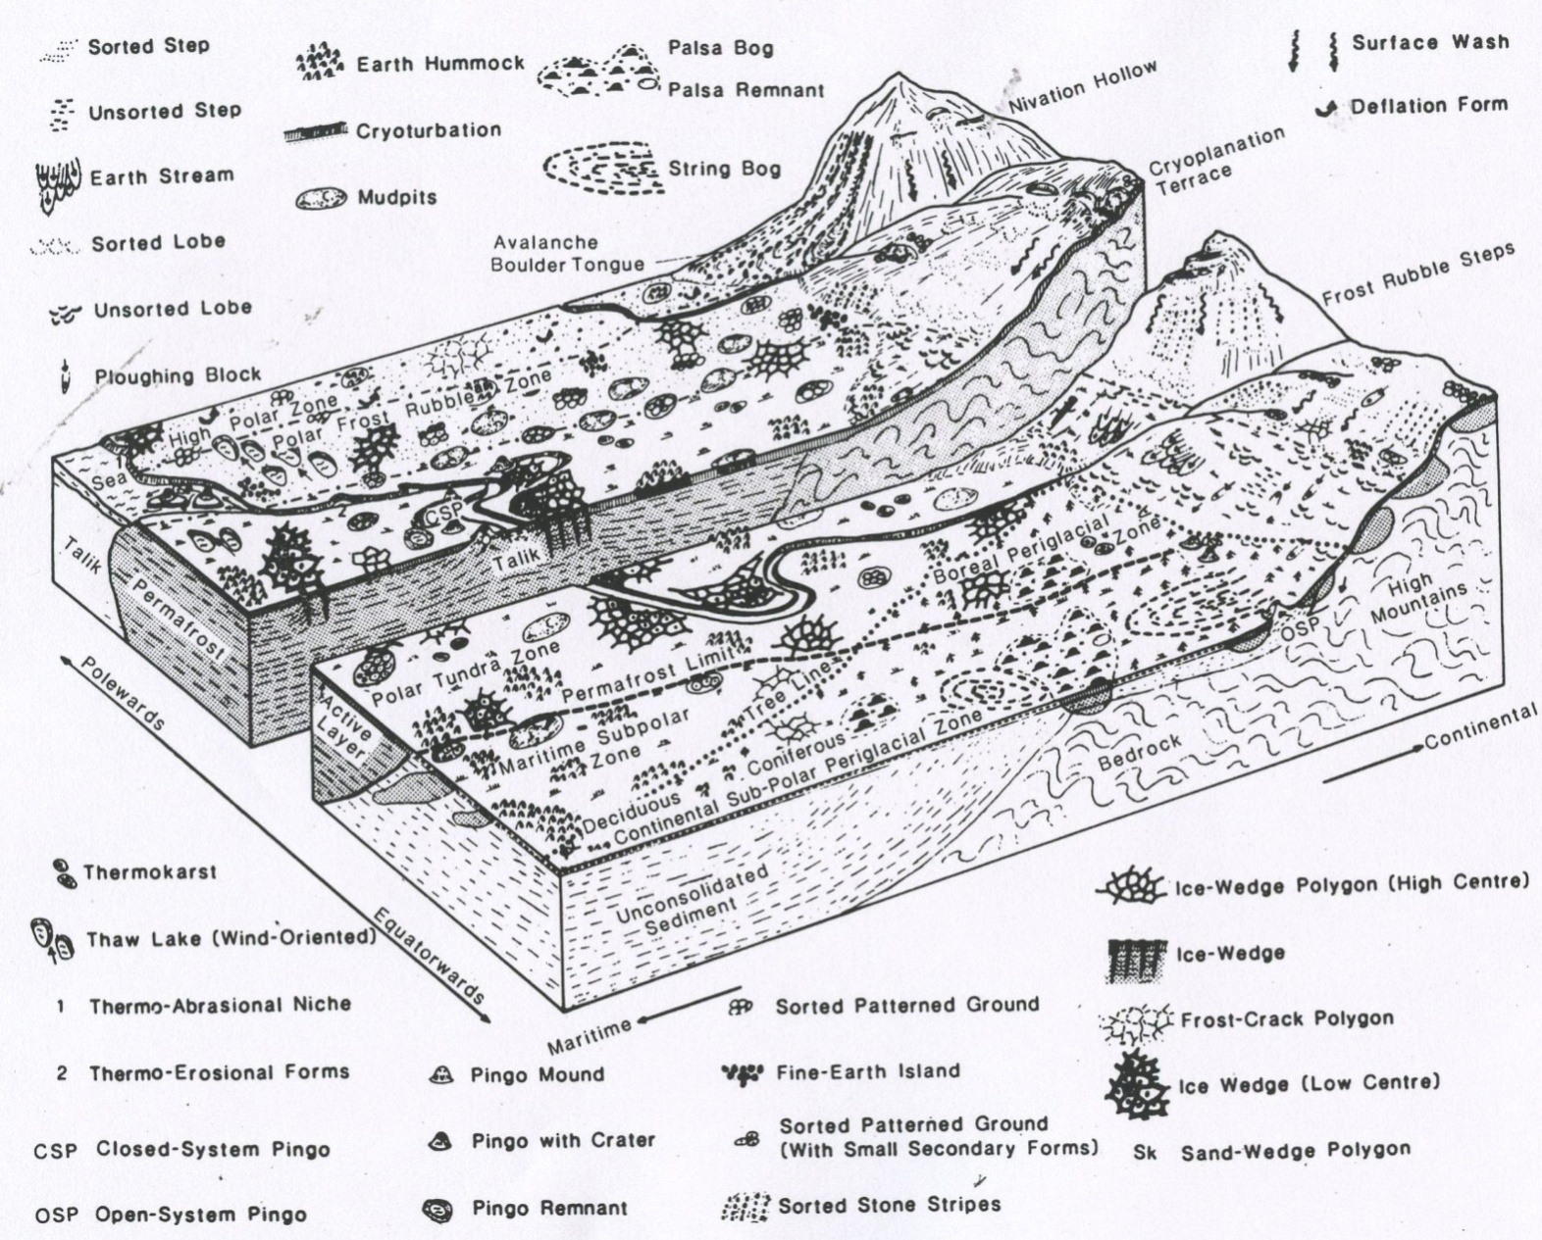
Figure 3.21 From Karte (1979). Characteristic landforms of the periglacial morphogenetic zone shown along two axes representing polar to warmer climates and maritime to continental environments

Slide 22
Figure 3.22 from Fookes et al (2007) Schematic model of a periglacial landscape

Slide 23
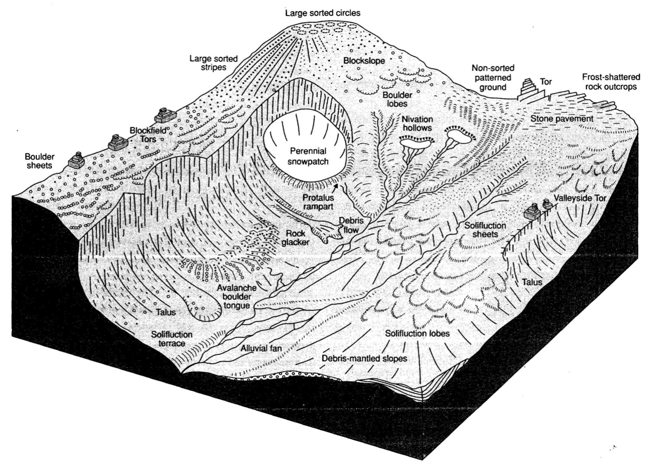
Figure 3.23 Late Devensian permafrost landforms on British Mountains (after Ballantyne & Harris, 1994)

Slide 24
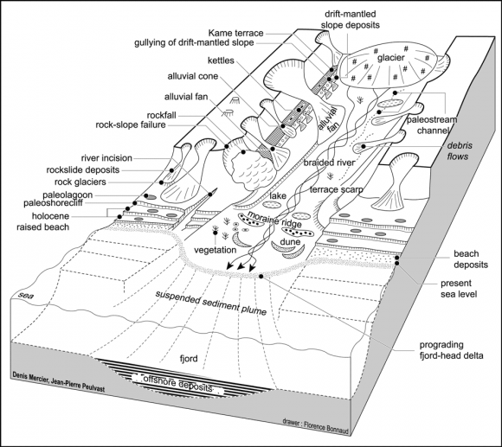
Figure 3.24 from Ballantyne 2002. Schematic representation of paraglacial features and processes

Slide 25
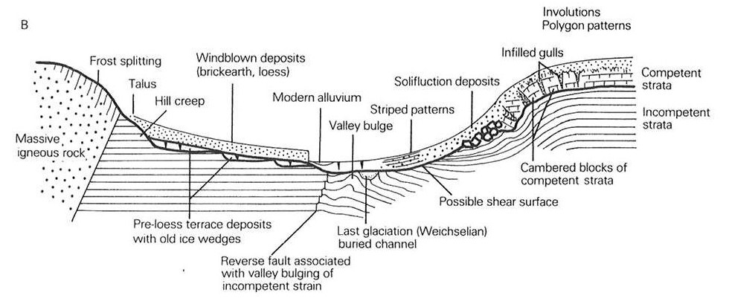
Figure 3.25 Typical field relations of important periglacial features and deposits (after Higginbottom & Fookes, 1971)

Slide 26
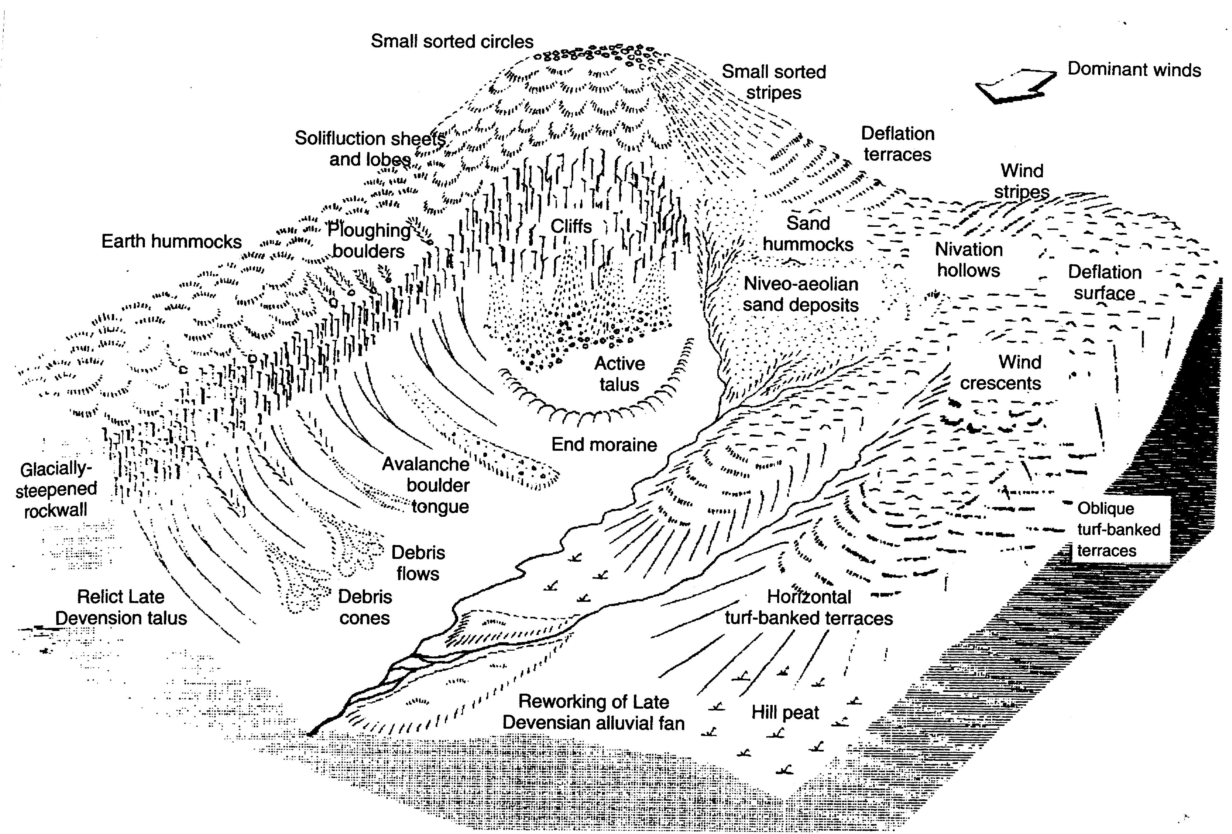
Figure 3.26 Relict periglacial landscape in the British Mountains (from Ballantyne & Harris, 1994)

Slide 27
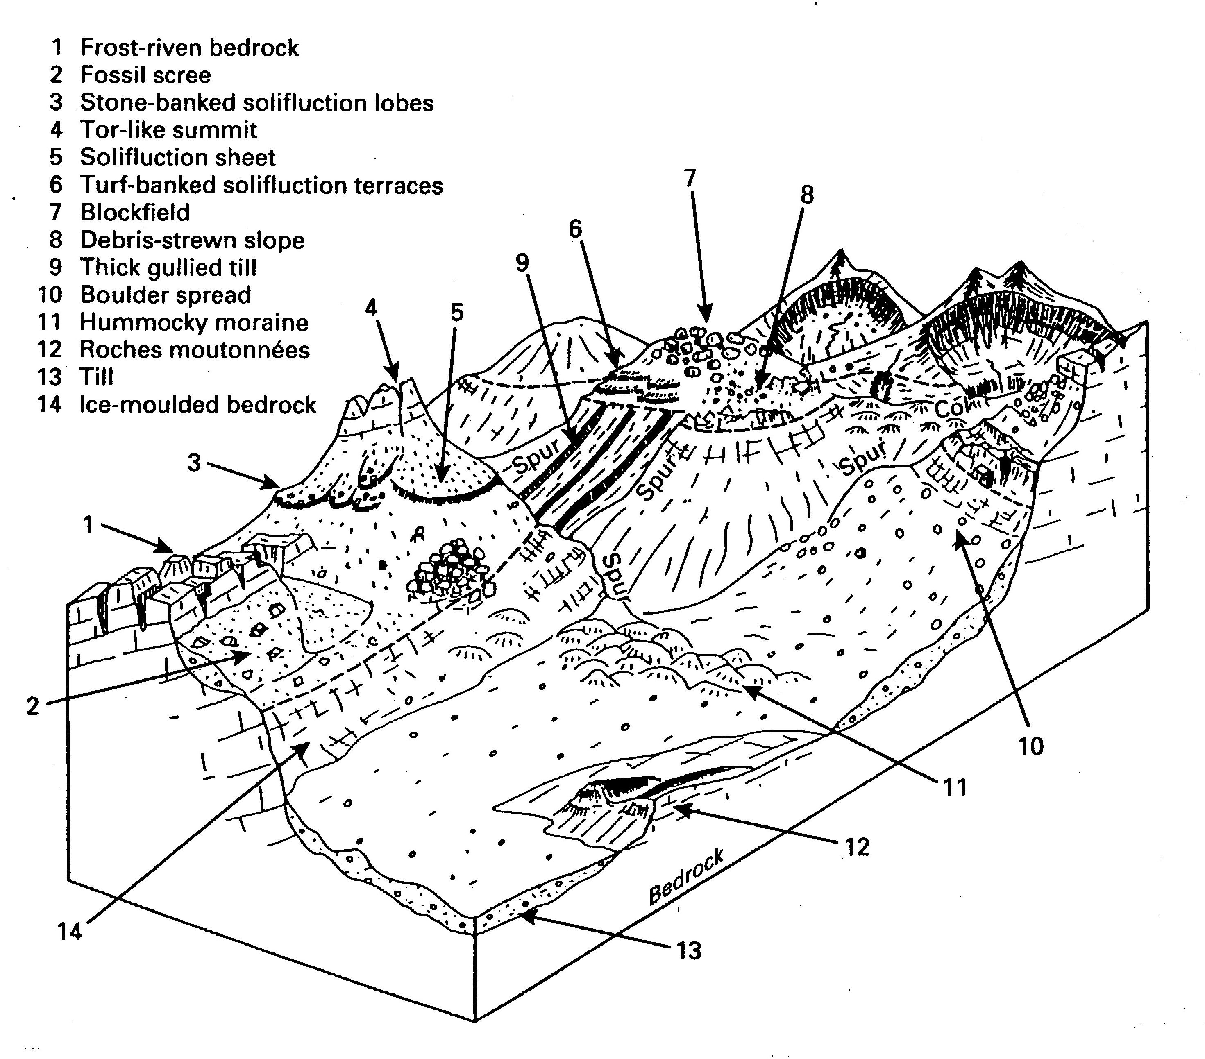
Figure 3.27 from Thorp (1986). Idealised features used for identifying trimlines and other types of glacial limits in mountainous terrain

Slide 28
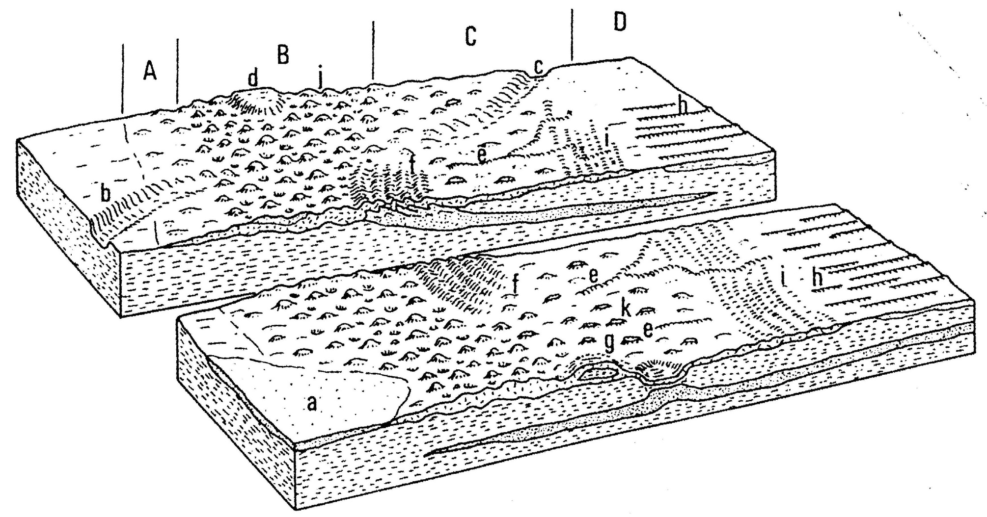
Figure 3.28 Idealised zones of glacial landforms and sediments on the prairies of North Dakota (from Clayton and Moran, 1974)
A) proglacial suite; B) supraglacial suite; C) transitional (submarginal suite); D) subglacial suite
a) proglacial lake ; b) proglacial meltwater channel ; c) subglacial meltwater channel or tunnel valley ; d) ice-walled lake plain ; e) esker ; f) transverse thrust moraines cupola hills ; g) prairie mound ; h) flutings ; i) transverse recessional moraines ; j) hummocky moraine ; k) isolated kames ;

Slide 29
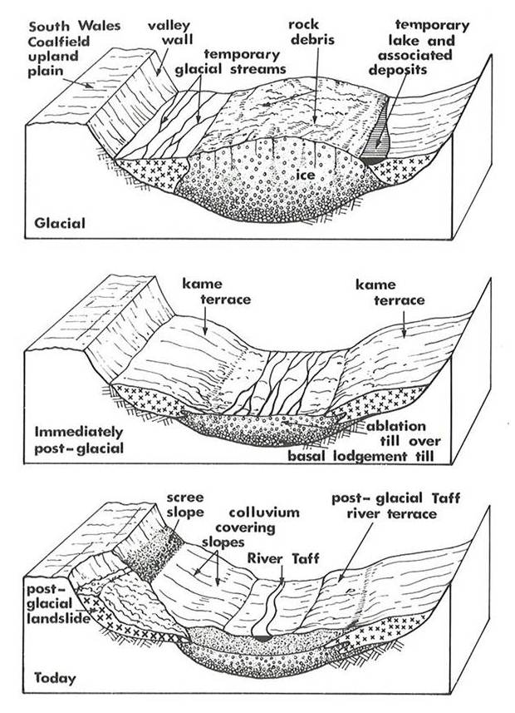
Figure 3.29 Development of the contemporary landscape in the Taff Valley as a result of glaciation and post-glacial processes (Fookes et al, 1976)

Slide 30
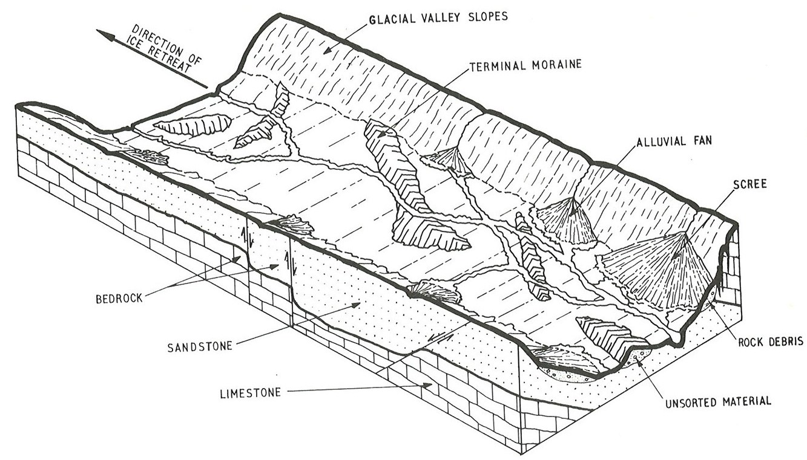
Figure 3.30 from Fookes et al (1976). Idealised relict features of a valley glaciation

